Slide 1
A.R.F (Autonomous Remote Feeder)
Kenny, Kevin, Davin, Michael & Khai

Slide 2
Intro
Problem: Pet owners may be unable to feed their pets reliably when they are away.
Our mission: To build a web client based pet feeder that is user friendly and can care for your pets tummy while you’re gone or would like to free up daily feeding time!
Here is a video of our current progress and what we are working on. Here is a Microsoft Teams link if you wish to talk to us.
Kenny Do (CE)

Slide 3
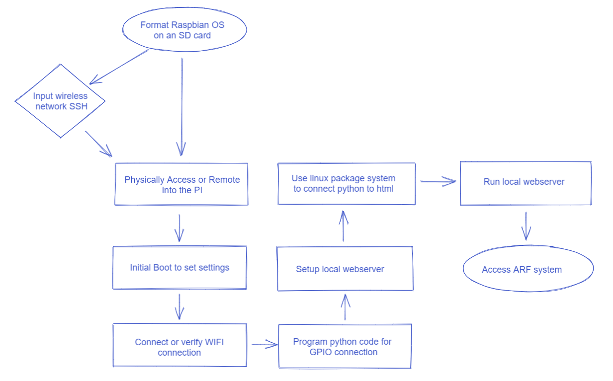
Flow chart outlining
Raspberry pi code
Michael Nguyen (CS)

Slide 4
Web Client
We are implementing code from our website we are making to run on the raspberry pi to do tasks for our project which include led lights turning on/off, turn on motor, and feedback for the user to notify the task was accomplished. Raspberry Pi will be connected to a database that will be linked.
Formatted OS from SD card that allows for physical access/remote to the Pi as well as allow for wireless network SSH to connect to the Pi.
From there the initial boot is started to set all the settings.
After which it will need to verify or connect to a Wifi source
Code is then written in Python to get the synchronization of the GPIO connection
We run our website that can execute the python code that can control the pins
Michael Nguyen (CS)

Slide 5
How our code works on a browser.
The main connection between the website and code is a linux advanced packaging tool (APT) called Flask.
It provides
Secure and maintainable web applications
Quick and efficient management
It allows us to run our python code quick and easily along with allowing it to run locally with our html and javascript.
We are using this because it provides rapid prototyping and since we are in the development phase, it helps us tremendously.
Khai Vu (CS)

Slide 6
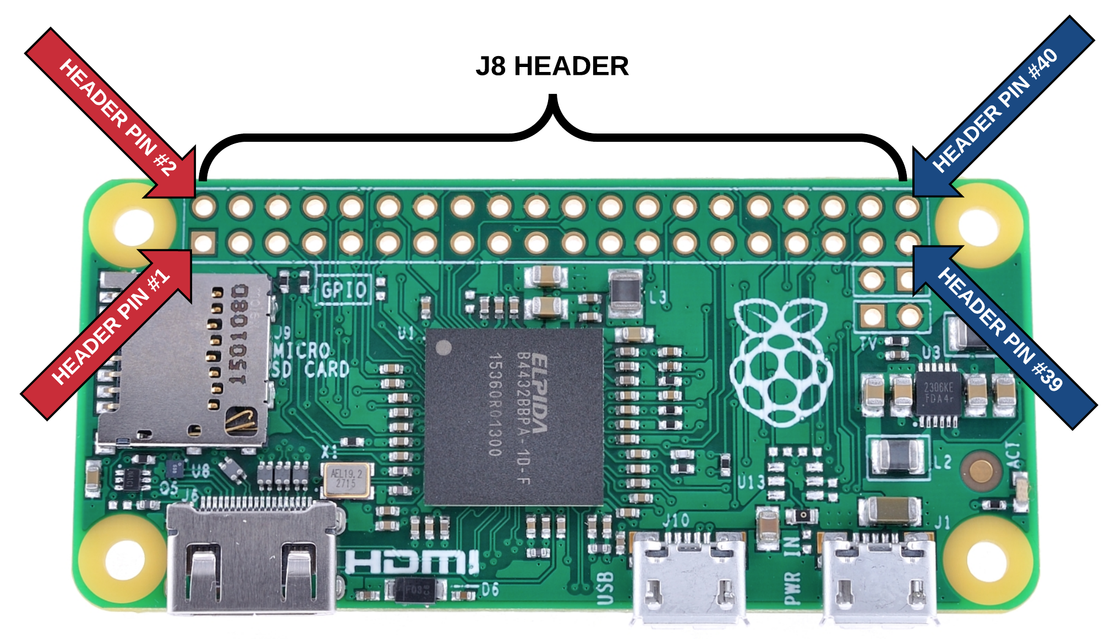
How our hardware runs from the code
We are using a package called Raspberry Pi GPIO, also known as RPi.GPIO.
This allows us to control the GPIO pins on the physical Pi. By using this package, we are able to send signals to power pins.
We currently have a LED setup to one of the powered pins (24), which we are using for testing.
Having this work means that we are able to control the major foundations of our product. We will be able to control servos, motors, and other electrical/mechanical functions that make up our pet feeder.
This includes
Dispensing Food
Setting up a timer
Manual interrupts of dispensing
Khai Vu (CS)

Slide 7
Web Client
From there a local web server is created
Unix linux package is installed to get the Python to connect to the local web server
Now the local web server will be ran
Lastly this will enable us to connect to the ARF system
Davin Sonexart (CS)

Slide 8
Web Client
Will run the web server on the raspberry pi
Using a WAMP server to test code and functionality
Will need to setup a LAMP to host the web client on the Raspberry Pi
Using a mySQL database to hold information, specifically for the automatic feed times at this moment
Will be able to access and modify the table if need be
Will need to be able to directly influence hardware on the Pi that will be controlling the feeder from the web server
Will need to figure out how to access the server from the internet and not just a local network
Davin Sonexart (CS)

Slide 9
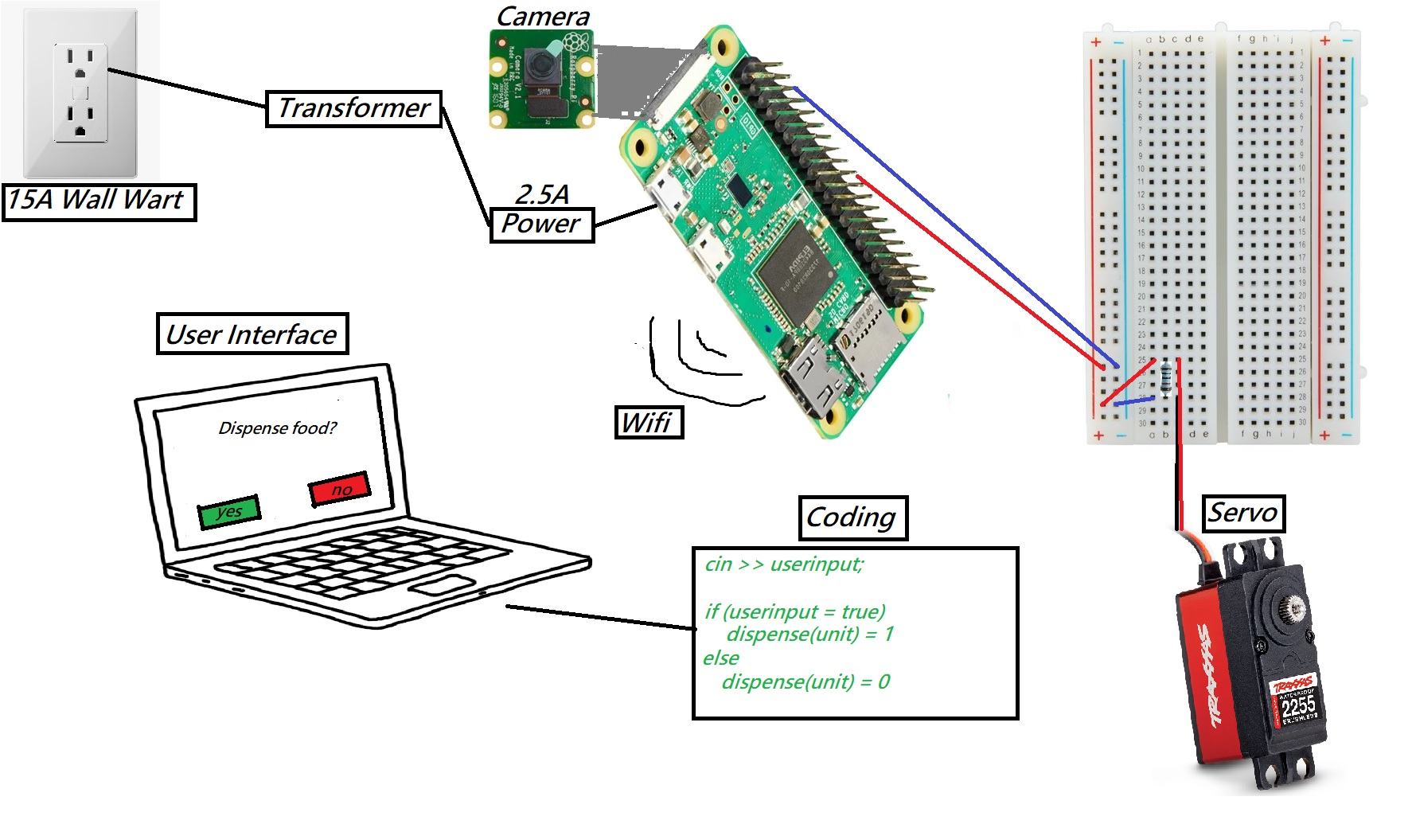
Electrical Flow Chart
Kenny Do (CE)

Slide 10
Flow chart CE/EE (Kenny)
From an electrical standpoint, all of the electricals are powered through a wall wart rated at 15A
The raspberry pi is the heart and brain of them all, connecting the hardware to the software
The PI receives the signal from the user, translates that into an electrical signal and then is outputted to the servo
All of this information is transferred from the internet, through the IoT, through WiFi, into the Pi
This all then dispenses the food for the user
Kenny Do (CE)

Slide 11
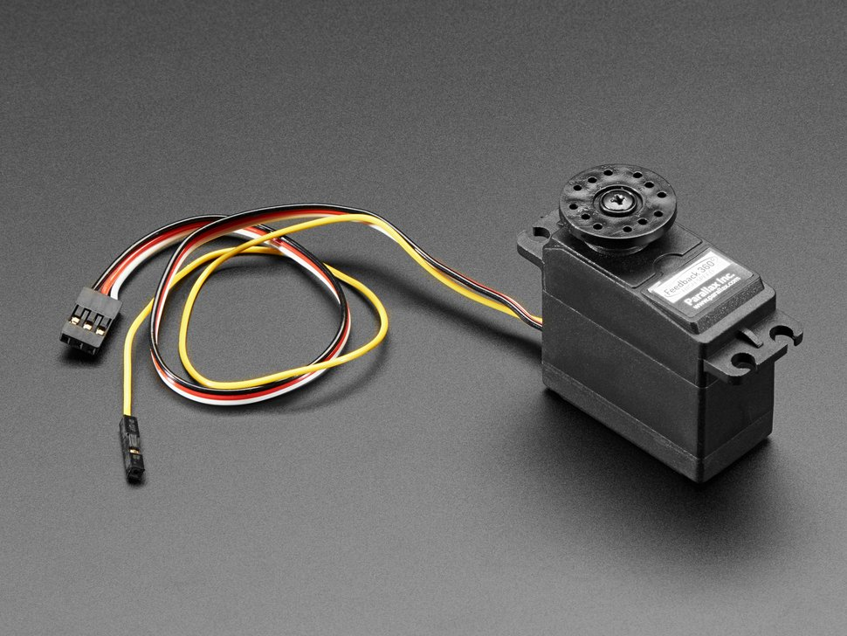
Working Components
Parallax 360 Servo
Used as main dispensing mechanism
Connects to a GPIO that sends signals to rotate at certain intervals
*needs to be setup for feedback still
*Will connect to a spinner that separates the hopper from the dispensing tube
* = not functioning yet but is intended to later on
Kevin Perez

Slide 12
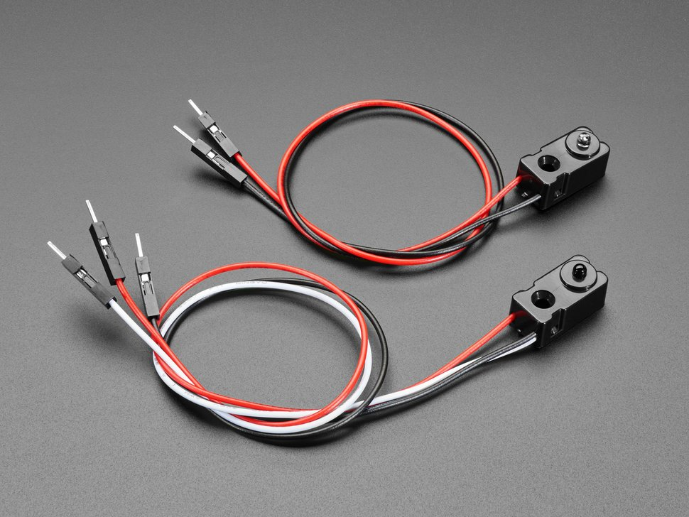
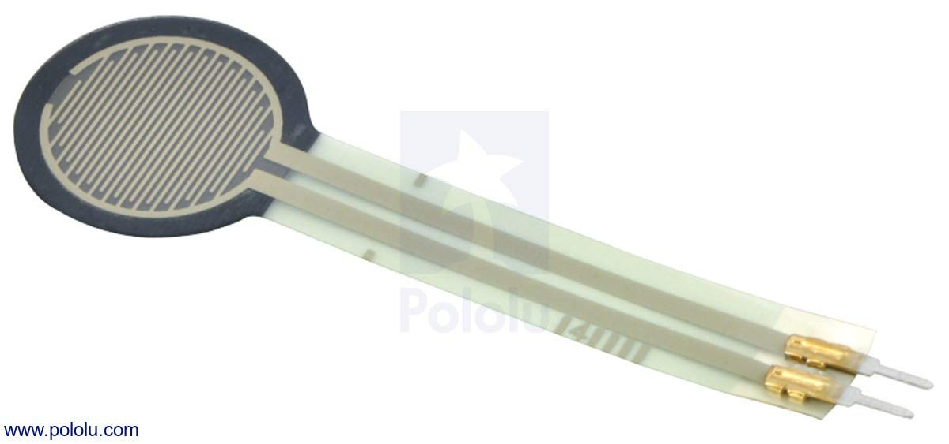
Working Components
Infrared Sensors
Monitors food level in the hopper
*When levels become to low we want it to send an alert
*may change component later to a different sensing method but this one does work!
Force Sensitive Resistor.
Can tell when there is a force exerted on the bowl.
lets you know when food has been dispensed as a backup precaution to make sure feeding cycles haven’t been missed.
*may upgrade to a better component later.
Kevin Perez

Slide 13
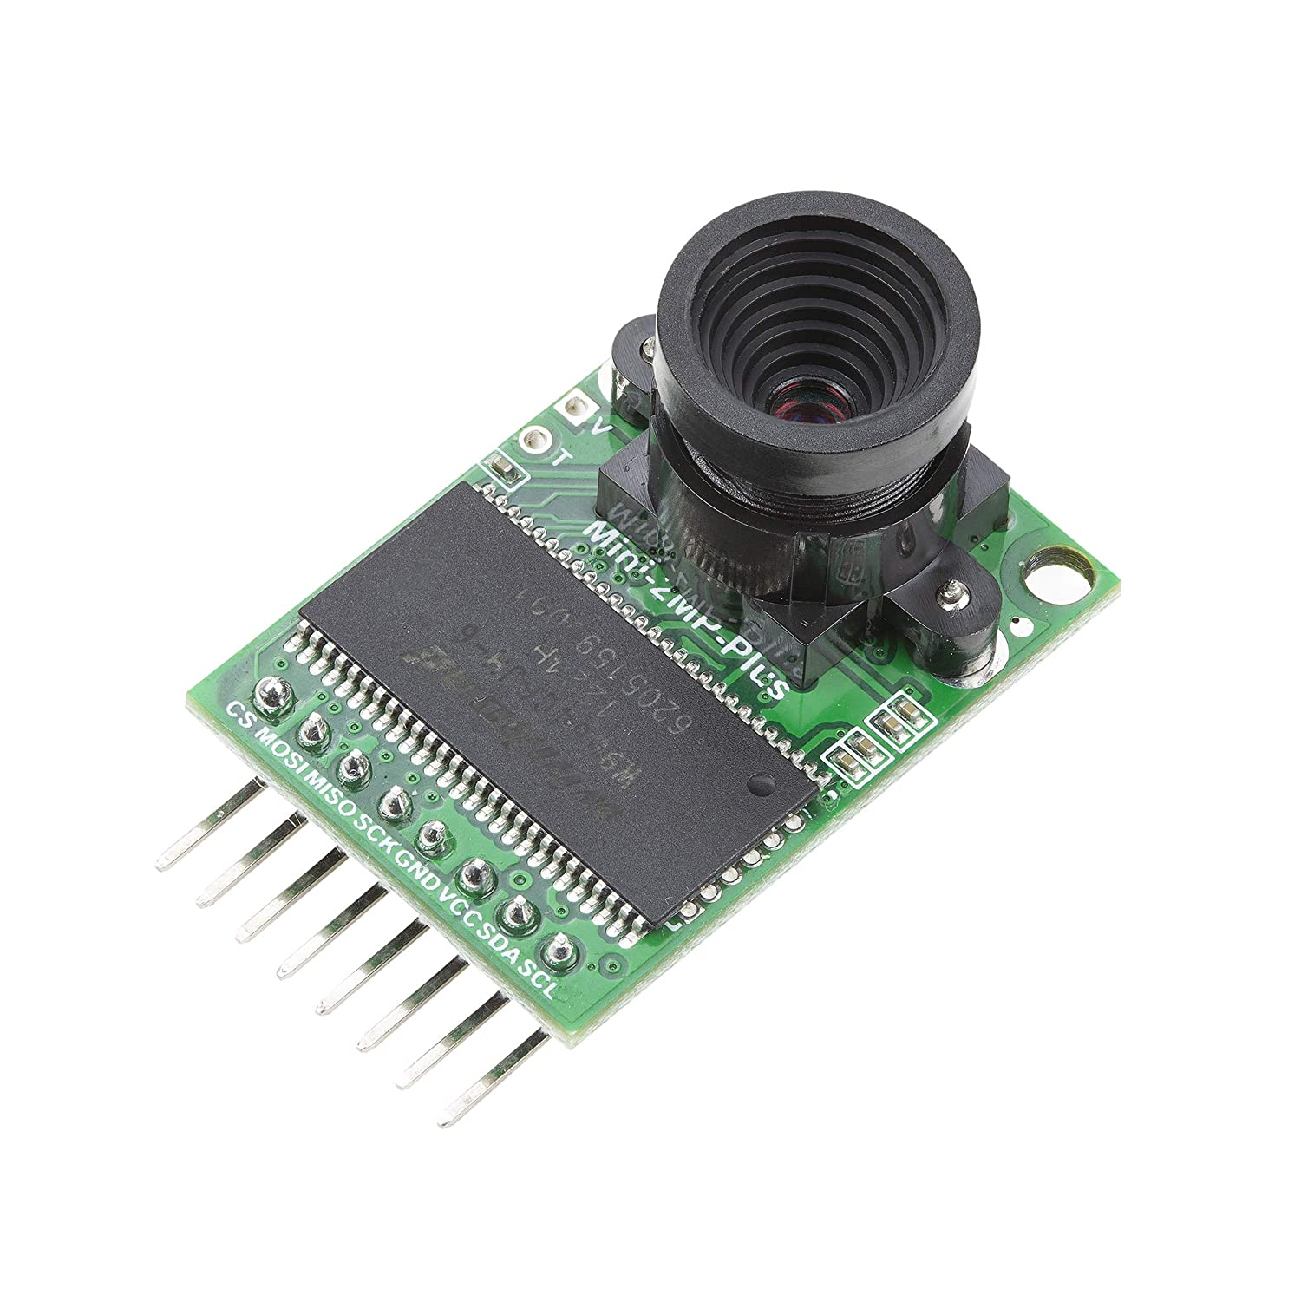
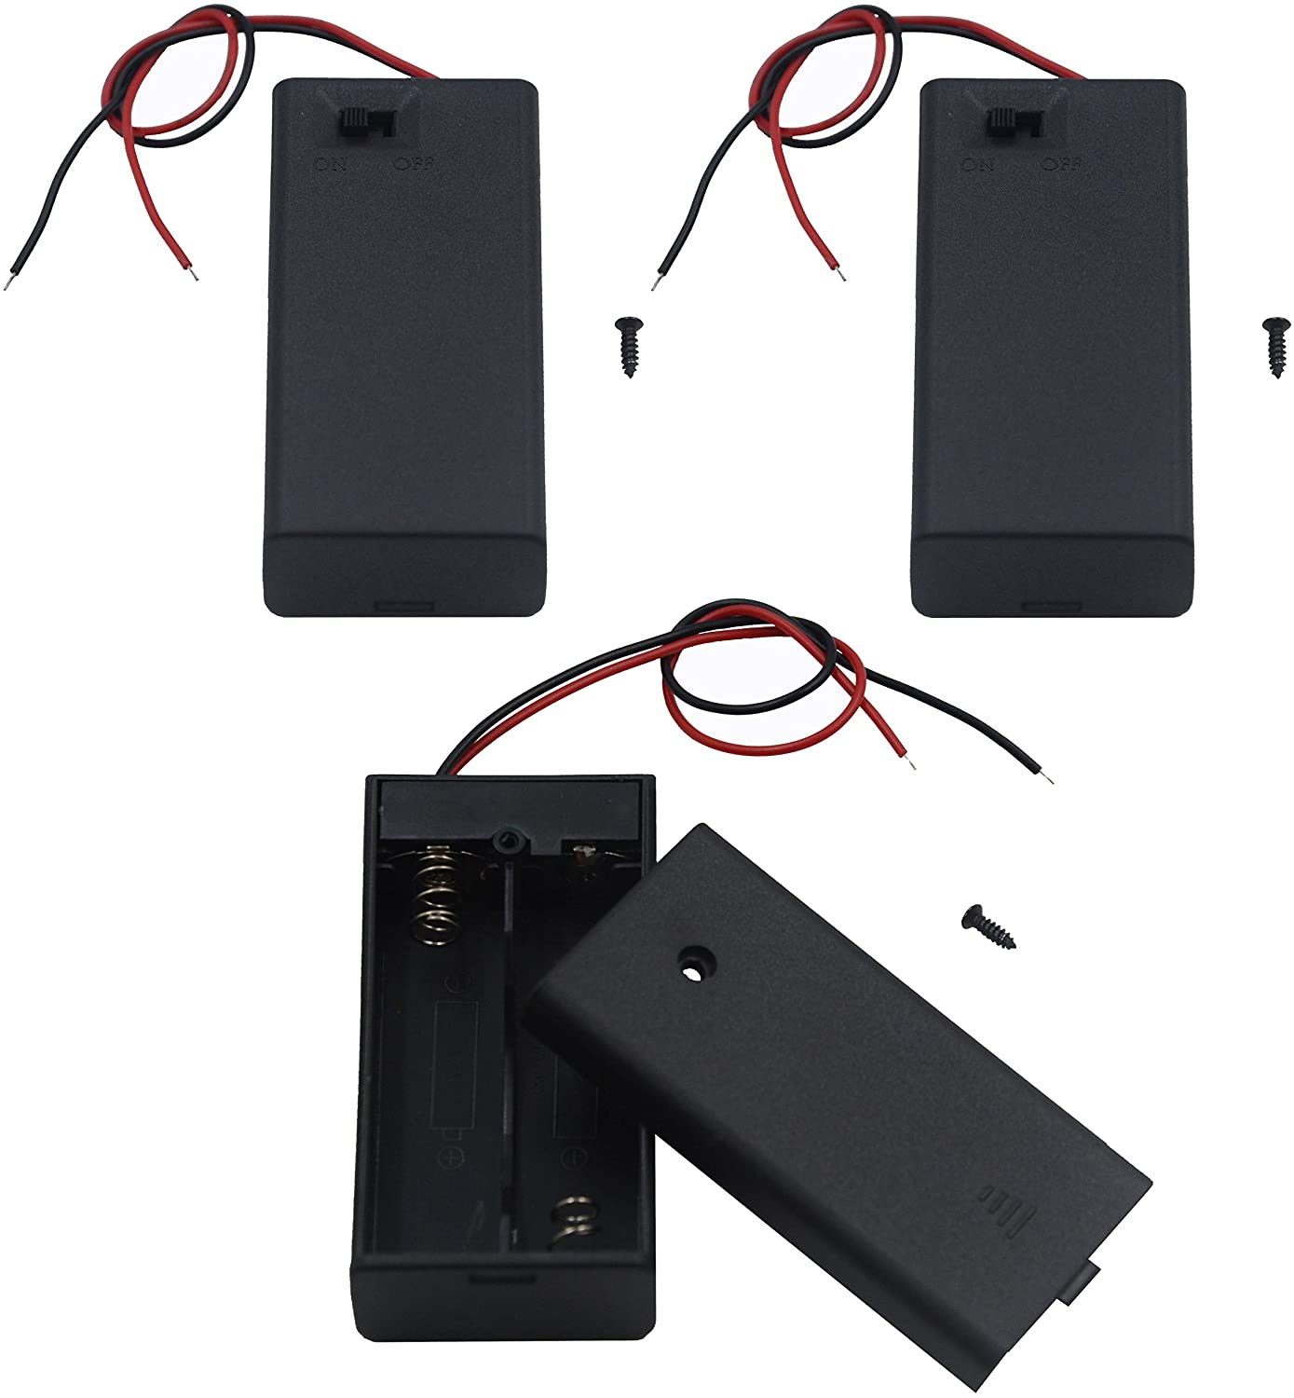
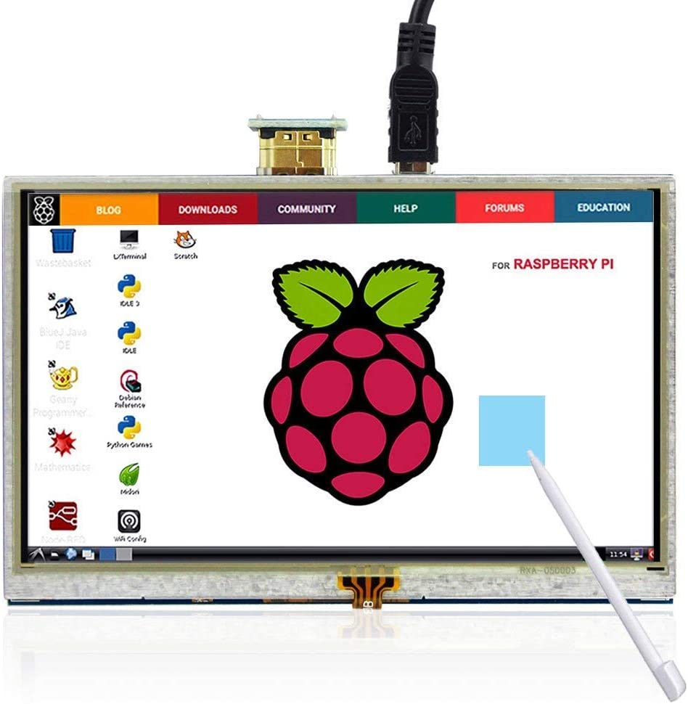
Components planned
PI 0W Camera
Can be used to monitor your animal when you’re not around!
See they’re eating and happy
Positive experience for the pet owner
Battery Backup
In case of power failure feed times aren’t missed
Needs to be enough power to last at least a day.
LED Screen
You could program the feeder in person
Look at camera pics and feeding times
metrics?
Kevin Perez

Slide 14
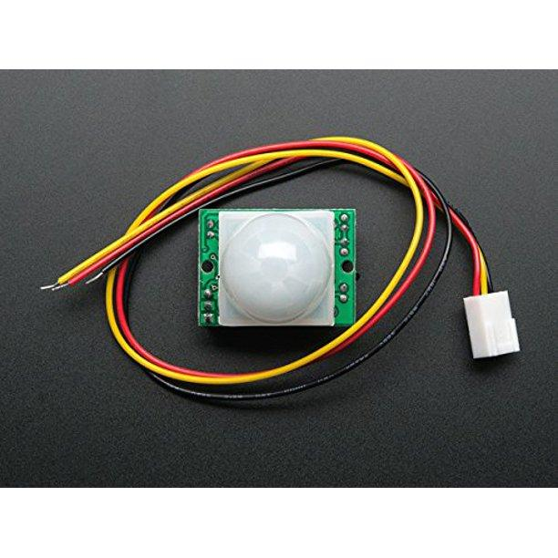
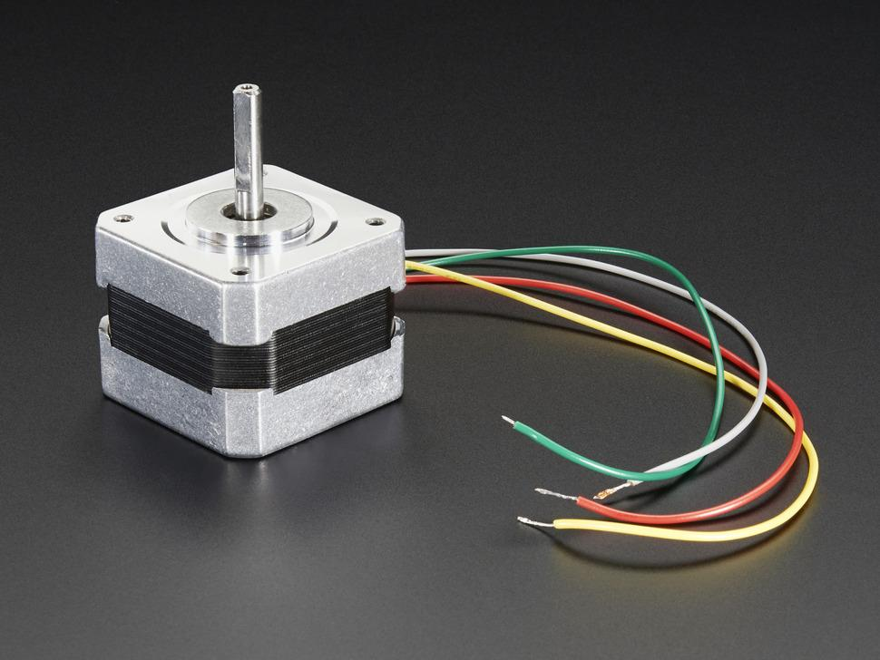
Components Planned
Motion Sensor
Can detect motion at a certain distance to let the owner know their pet has come to eat.
NEMA 17 stepper motor
Backup idea to another rotational servo or motor
Provides up to 2Amps and enough power to move food through the dispenser.
Cons: could be loud.
Kevin Perez

Slide 15
Electrical issues to Discern
Want to step up to a higher voltage and need to separate that voltage from the 5v input on the raspberry pi. Looking for 9 to 12V that can run a higher power consuming motor for our main dispenser.
Component | Voltage | Amps (worst case) | Power consumed
Servo | 5-8V | 1.2 A
IR sensor | 5V | .020 A
Force Resistant Sensor | 3.3-5V | .003 A
Camera | Not exact, not a lot | Not exact, not a lot
LED Screen | 5V | < 1 A
Motion Detector | 3.3-12V | < 0.2A
Nema 17 Stepper | 12V | 0.350 A
Kevin Perez

